Slide 1





“People are overdosing on drugs that we don't know”
Addiction treatment providers’ perspectives on training gaps regarding the emerging substance use patterns in Scotland
Beata Ciesluk¹, Dr Greig Inglis¹, Dr Adrian Parke¹, Dr Lucy J. Troup^{1,2}
¹School of Education and Social Sciences, UWS
²Norwich University of the Arts

Slide 2
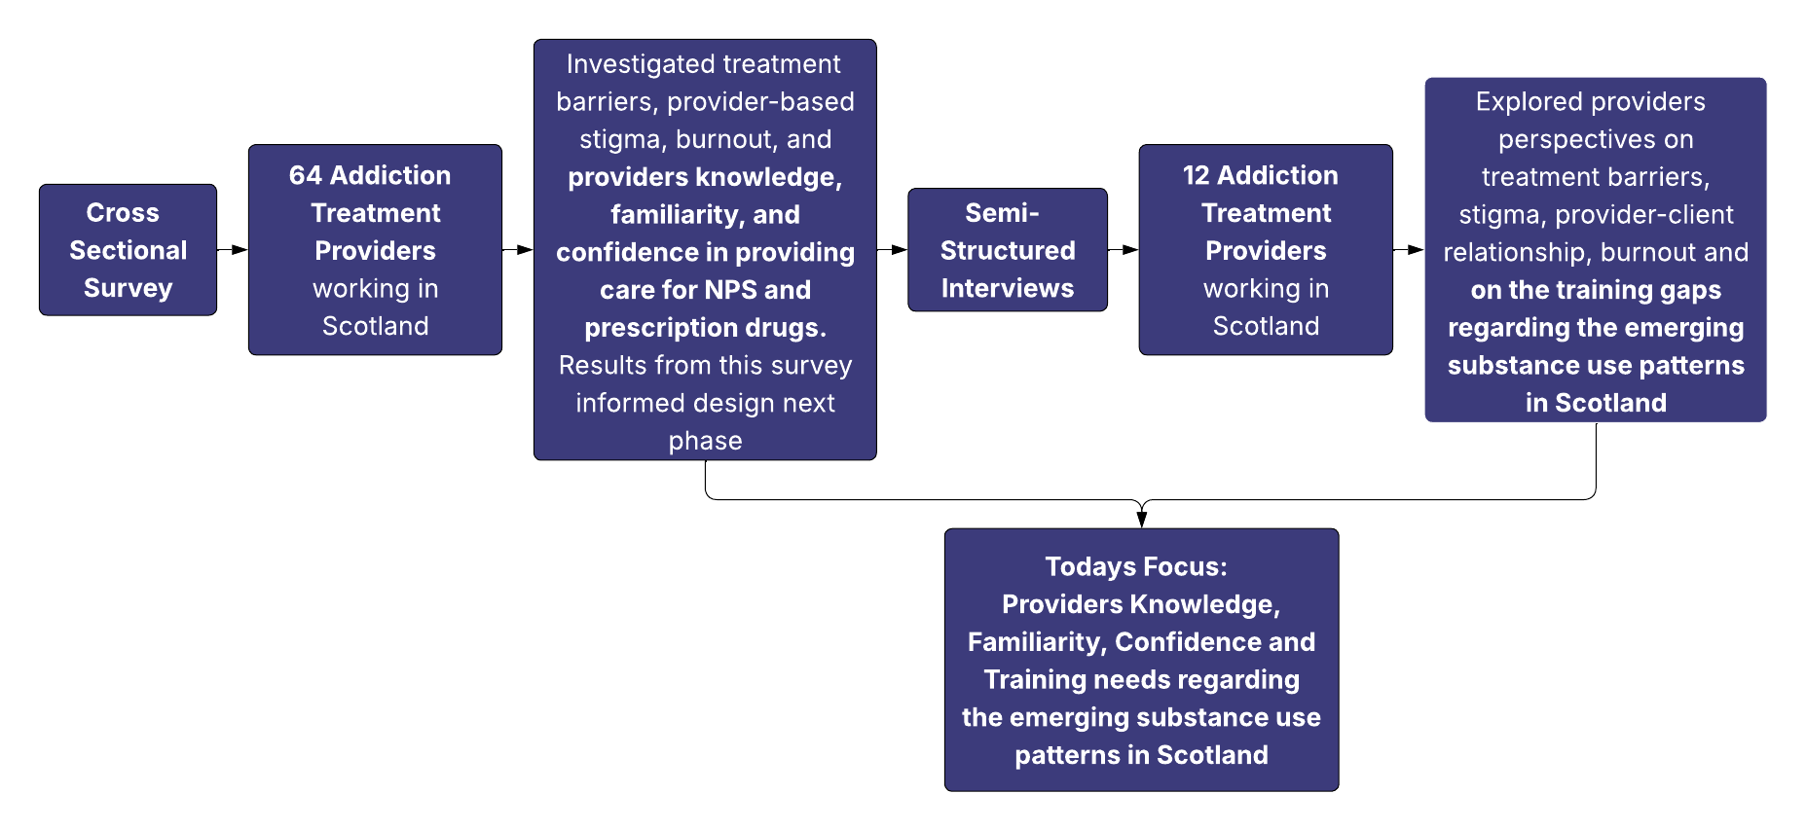
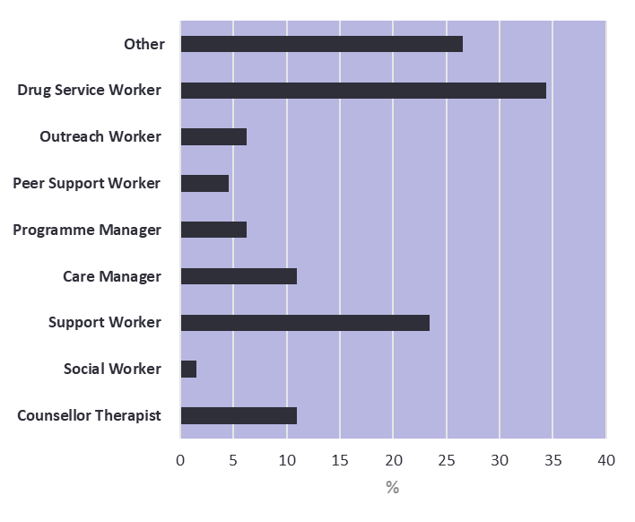
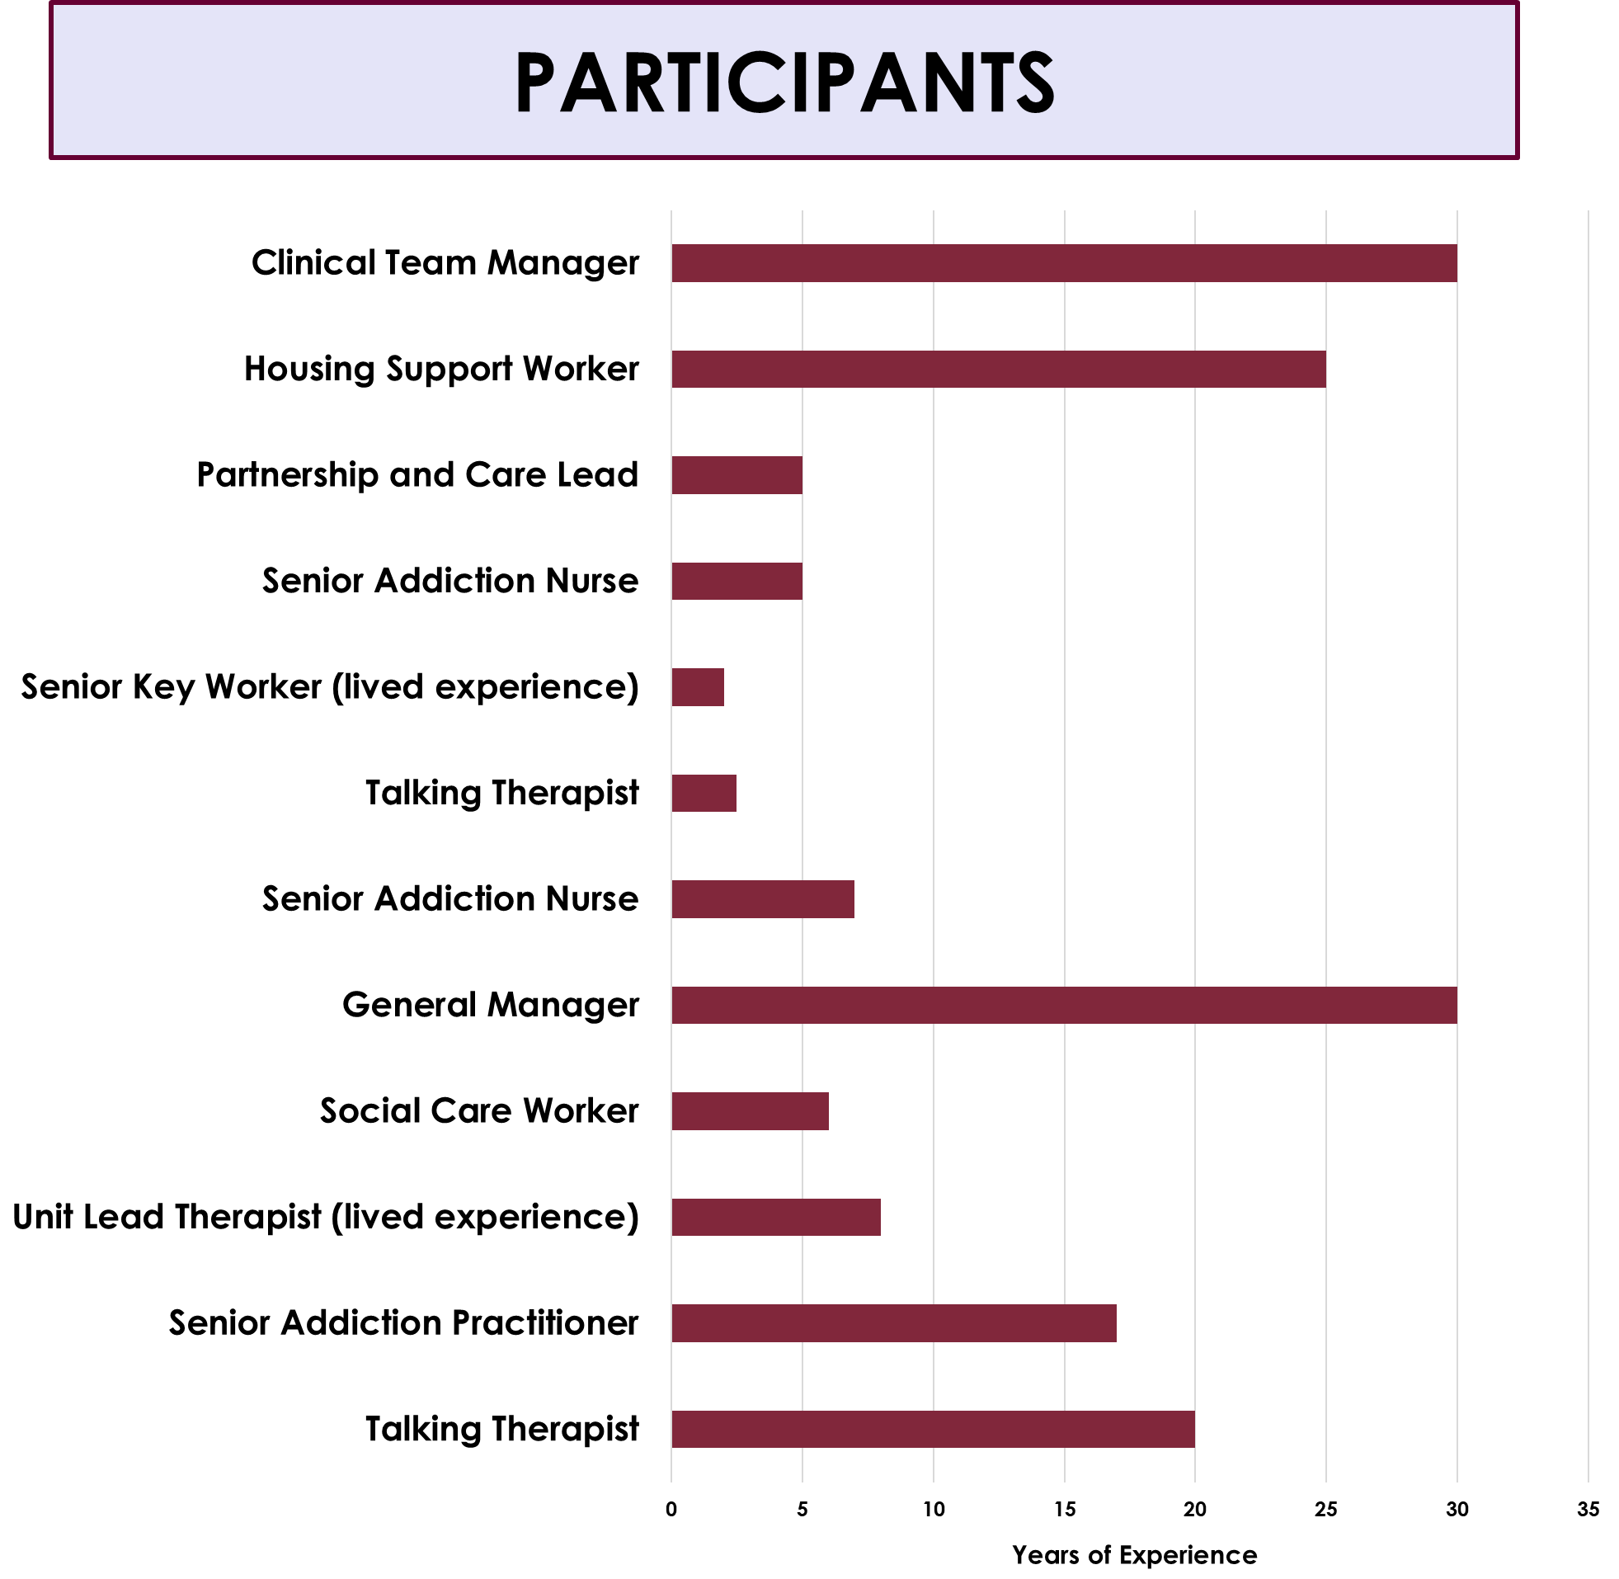
Methods

Slide 3

Background
Knowledge and Training Needs
Are current addiction treatments in Scotland prepared to support these emerging drug trends and harms, and are there areas for improvement or training to support treatment access and recovery?
Increase in prescription drug misuse, novel psychoactive substance misuse and their related harms and deaths (Ciesluk et al., 2024)
Ramos et al (2020)
Investigated knowledge and training needs of healthcare professionals regarding NPS and Prescription Drugs
Providers had “basic” knowledge, and expressed interest in more training, as poor training was currently received
England-based research, need for further investigation conducted in Scotland and wider range of addiction treatment providers

Slide 4
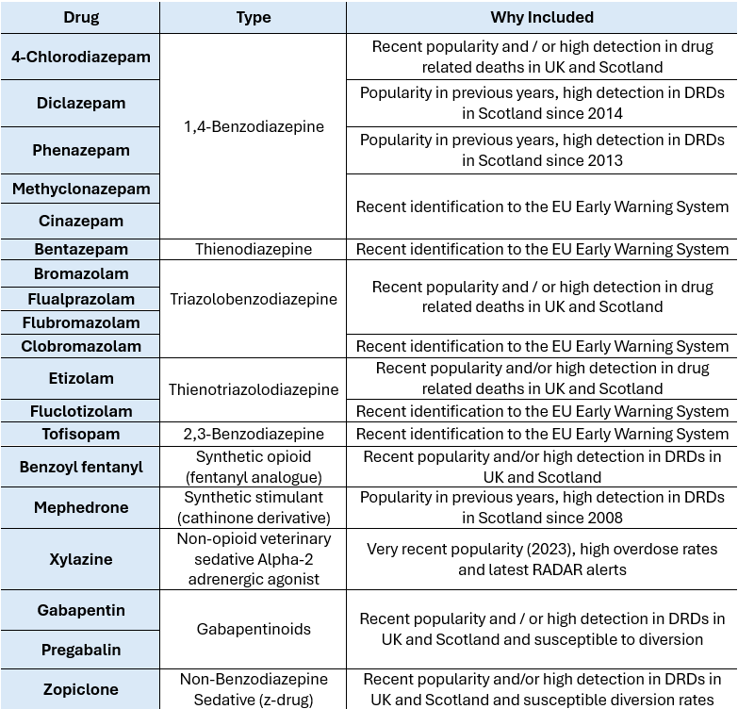
Background
Knowledge and Training Needs
Increase in prescription drug misuse, novel psychoactive substance misuse and their related harms and deaths (Ciesluk et al., 2024)
Ramos et al (2020)
Investigated knowledge and training needs of healthcare professionals regarding NPS and Prescription Drugs
Providers had “basic” knowledge, and expressed interest in more training, as poor training was currently received
England-based research, need for further investigation conducted in Scotland and wider range of addiction treatment providers

Slide 5
Survey Findings
Familiarity: “Have you heard of this substance?”
Prescription drugs (e.g., Gabapentinoids, Zopiclone) were found more familiar to participants than NPS (e.g. Tofisopam, Phenazepam, Flurazepam, Flualprazolam)

Slide 6

Survey Findings
Rate your knowledge from poor (1) to very good (5)
4-Chlorodiazepam
Bentazepam
Benzol Fentanyl
Bromazolam
Cinazepam
Clobromazolam
Diclazepam
Etizolam
Flualprazolam
Flubromazolam
Fluclotizolam
Gabapentin
Mephedrone
Methylclonazepam
Phenazepam
Pregabalin
Tofisopam
Zopiclone
Xylazine
Higher familiarity scores were associated with higher perceived knowledge of these substances
How confident are you in providing advice for the misuse and adverse effects for these substances?
Higher familiarity scores were associated with higher confidence

Slide 7
Survey Findings

Slide 8
Exploring training needs further – Interviews
Survey found:
Low familiarity and knowledge
Confidence in providing care high
Strong demand for training
Interviews Explored:
Is specialised drug knowledge on emerging subtances in Scotland important for providers supporting PWUD?
What training is needed?
What barriers to training exisit?
What training format would be best?

Slide 9
Divide in perspectives?
Supports engagement, trust, recovery
Very Essential
Helps to minimise risk and overdose
“There isn't any training, and people are overdosing on drugs that we don't know what's in them”
“it would be hugely helpful, not just an e-mail to alert us, but to actually give us in depth training about what it is, what sort of side effects come along with it, where it's becoming available, who's taking it, it would help keep us up to date…rather than sort of finding out from clients…because that feels like you're on the back foot a lot of the time…makes you feel as though you're missing something especially if you're working with clients who have got that direct experience with that specific drug”
Is specialised drug knowledge essential?
Focus should be on broader aspects of recovery
Not Essential
Information can come from service users
“I think we can sometimes get lured into thinking that knowing the drugs that's going to help us manage and I don't know that it does. Clients know all about drugs, they know more than we'll ever know what they don't know is relationships, right living or purposeful activity. The other things that will make the changes in the recovery”
“you don't necessarily have to have every single drug down and know all the things that it can do to a body you don't. You don't need that, people feel they need it because they don't want to be out their comfort zone and they don't want to feel ignorant in front of the client but in our experience…the client…They don't they don't mind telling you”

Slide 10
Barriers to training and knowledge
Rapidly changing drug use trends
Limited time and recourses
Difficult to Keep up
Substances Evolve
Workload
Limited Opportunities
SPECIALISED DRUG TRAINING VIEWED AS UNATTAINABLE
“everything is changing…I could see why they don't create many resources as they don't want to put something out and then it's outdated but think training is hugely important just trying to get the right balance”
“Addictions always change, and it's not the easiest subject to work in but there's limited education out, there's limited training which is the difficult side”
“You're never going to know what's in everything, because everybody cuts things different, everybody mixes things different…so, it's alright saying we would like more training, but nobody knows what's in them”
Uncertainty around substances used
“you hear your managers go “I was going to send such and such for training but due to illness and annual leave, we need cover for the service. We can't go anymore”
Service Users Unaware
Adulteration and Polydrug use

Slide 11
Recommendations:
1
More accessible training
Protected learning time, increased opportunities for training
2
Flexible Delivery
In-person training and online recourses
3
Lived Experience Involvement
Including lived experience in training delivery and design
4
Increase in drug testing facilities
Wider access for PWUD to test drugs
Better awareness of current drug patterns
“the patients hand you drugs and says have a go and drug screen that and see what's in it. Obviously, you can't do that. You've got to dispose of it…why can't I do that? Why can't I just take it and send it to the lab and get it tested? Why is that not available? that would help with the training and education because you can then say, well, I've had this back and this is what's in it and you're went and read up on that up on that to see how to manage that or how to how to help with that addiction”

Slide 12

Conclusion
Providers are increasingly being asked to respond to rapidly changing drug trends where neither providers or the people using substances can always be certain what is being taken
Differing views on specialised drug knowledge.
Many wanted greater opportunities for support.
Clear need for protected learning time, flexibility and lived experience involvement in training.
More drug testing services and timely information for emerging drug trends for providers and PWUD.
“training is hugely important just trying to get the right balance”

Slide 13
Thank you and stay in touch!
Email: beata.ciesluk@uws.ac.uk

